Slide 1



2023 Spring
The Examination of Term Premia: Pricing, Influence, and Forecasting
815 Fixed Income Final Project
Chuyi WANG Yilin LIU Jingxiang ZOU

Slide 2
Fitting of ACM model based on GSW dataset
Term Premia as Risk Factor
Term premia prediction
Two empirical findings
The relationship between Inflation and Term Premium
CONTENT

Slide 3
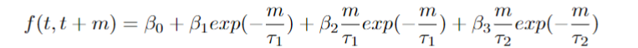
The Svensson Model
The Svensson model is a parametric model used to estimate and represent the term structure of interest rates or the yield curve. The Svensson model aims to provide a smooth, continuous representation of the yield curve while minimizing the differences between the model-implied yields and the observed yields for a set of fixed income securities.Below is the Svensson model of yields:
The Svensson model uses a four-component functional form to represent the yield curve. These components include: a constant term representing the long-term level of interest rates; a decaying term representing the slope of the yield curve; two exponential terms representing the curvature and a second hump or inflection point in the yield curve

Slide 4
The GSW Dataset
The Gurkaynak, Sack, and Wright (2006) paper, titled "The U.S. Treasury Yield Curve: 1961 to the Present " examines the behavior of the U.S. Treasury yield curve.
They find that the changes in the slope of the yield curve are informative about changes in monetary policy. They also find evidence of a positive inflation risk premium, meaning that investors demand higher compensation for inflation risk, and a positive real interest rate, meaning that investors demand compensation for the opportunity cost of holding bonds.
They estimated in the paper parameters of the Svensson model by minimizing the discrepancy between the fitted Svensson yield curve and observed market yields.Following their work, the Fed reports fitting results of Svensson model in the GSW dataset.

Slide 5
The ACM Model
The Tobias Adrian, Richard K. Crump, and Emanuel Moench model is a popular and widely used model for estimating term premia. The model is based on the idea that the term premium is the difference between the market expectation of future short-term interest rates and the average of past short-term interest rates.
ACM model does not rely on any specific assumptions about the shape of the yield curve or the dynamics of interest rates. This makes the model flexible and adaptable to changing market conditions. It has been found to provide accurate estimates of term premia, and it has been used in a variety of applications, including macroeconomic forecasting, monetary policy analysis, and risk management.

Slide 6




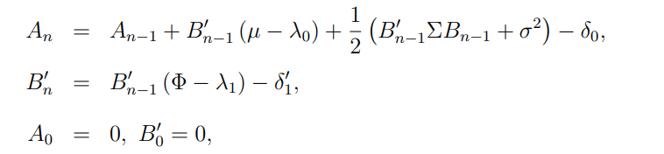
Model Estimation: 3-Step Approach
Step 1:
Step 2:
Step 3:
Iteration:

Slide 7
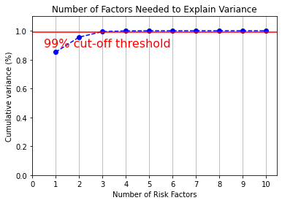
Determination Of Number of Factors
The authors note that prior research had suggested that 3 factors were sufficient to explain the dynamics of the term structure of interest rates, but more factors can improve the model's ability to explain the term structure of interest rates and forecast future changes.
They also note that the choice of 5 factors was influenced by practical considerations, such as the need to balance the trade-off between model complexity and accuracy. They state that *adding too many factors can lead to overfitting and instability, while too few factors can result in a poor fit to the data.*

Slide 8
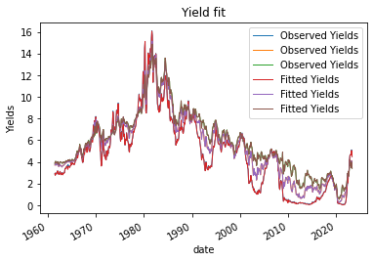
Our ACM model fit very well with the yield curve suggested by the Svensson model. We have successfully estimated the parameters of the model. We can use the term premia from our model to conduct interesting researches.

Slide 9
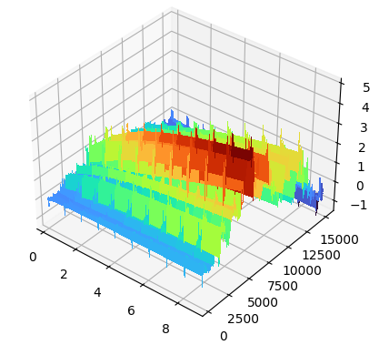
Term Premia as Risk Factor
To examine the potential of Term Premia as a risk factor for the market, we would like to regress VIX on the estimated Term Premia
Observing that the slope is the major characteristic of the Term Premia Curve, we use 10y TP as the regressor

Slide 10
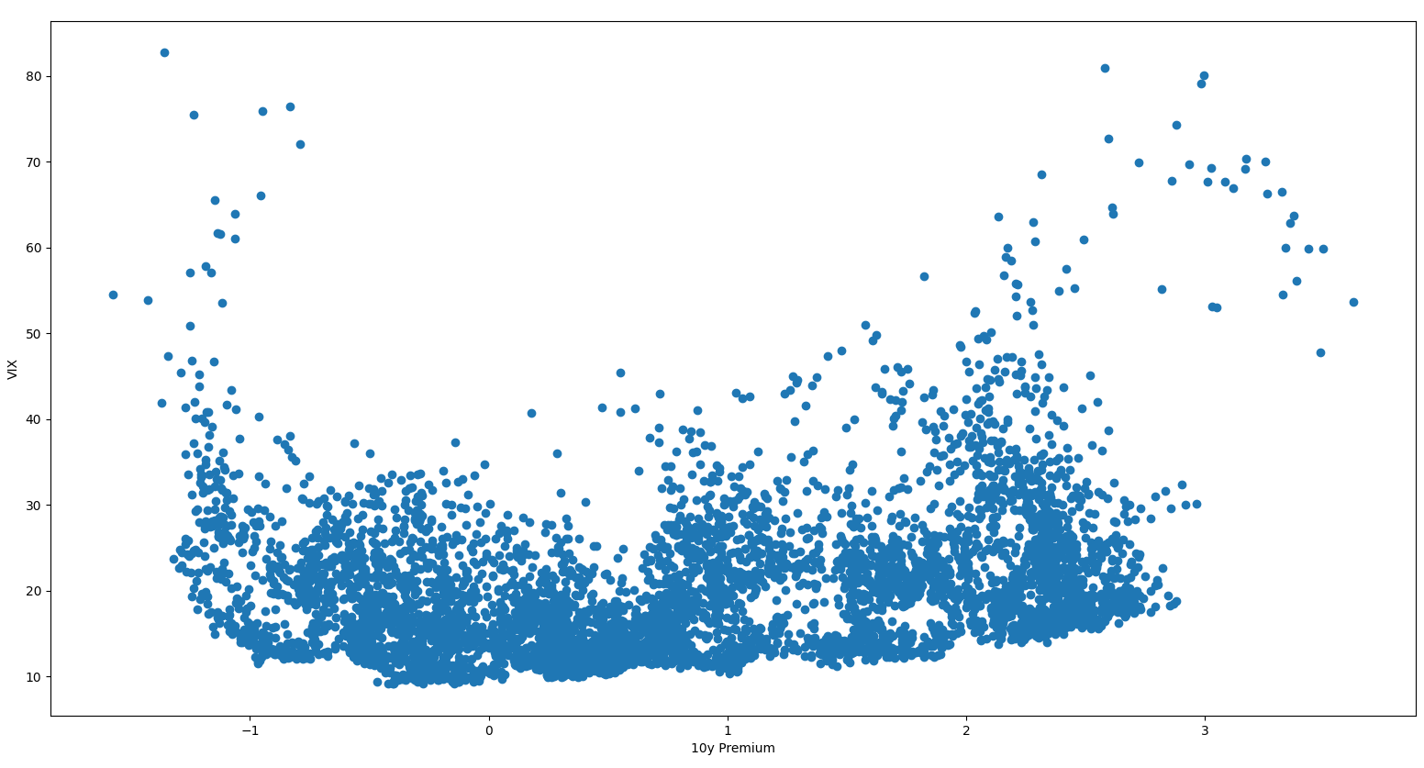
Relation Between Term Premia and VIX

Slide 11
Define the Structure
We see the relationship between two variables is in general convex but with asymmetric curvature. Empirically, we model the relation as following:
Log(VIX) = a * Exp(TP) + b / (TP + 2.) + c
Furthermore, we heuristically set a = b/16 to constrain the minimum between 0 and 1. Note: y = a * (x+2.)² + b / (x+2.) has minimum at x=0 => a = b/16
By OLS, we find a = 0.05, b = 0.7, c = -2 approximately

Slide 12
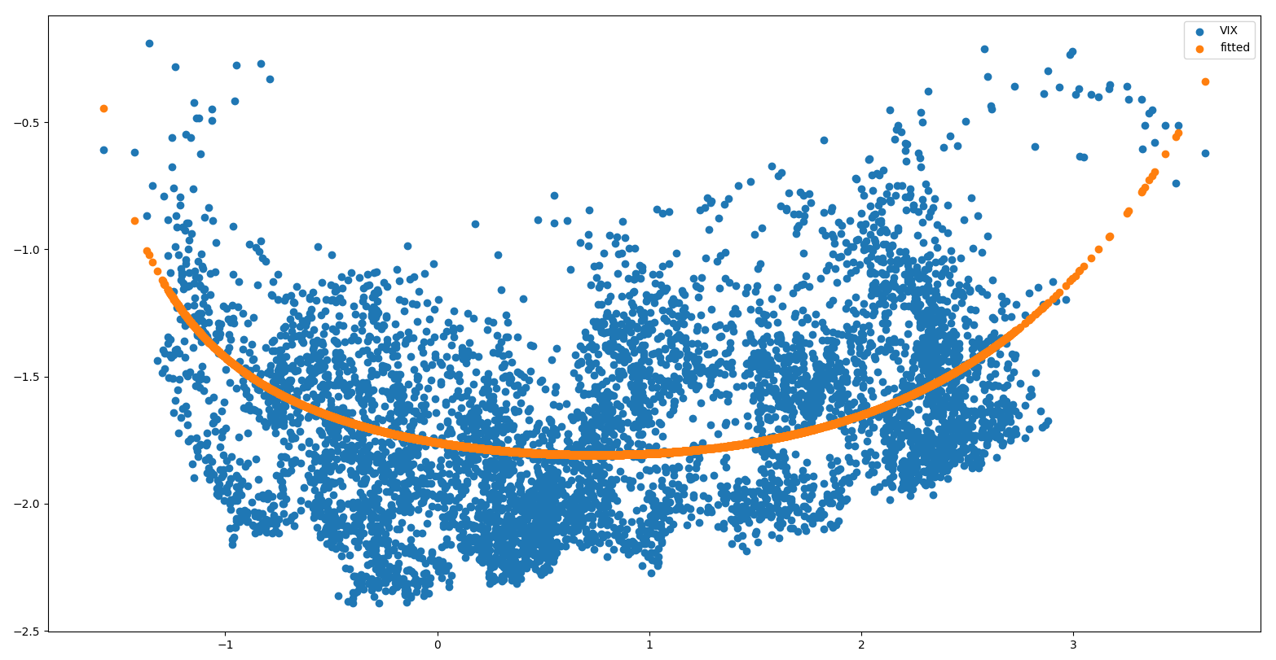

Slide 13
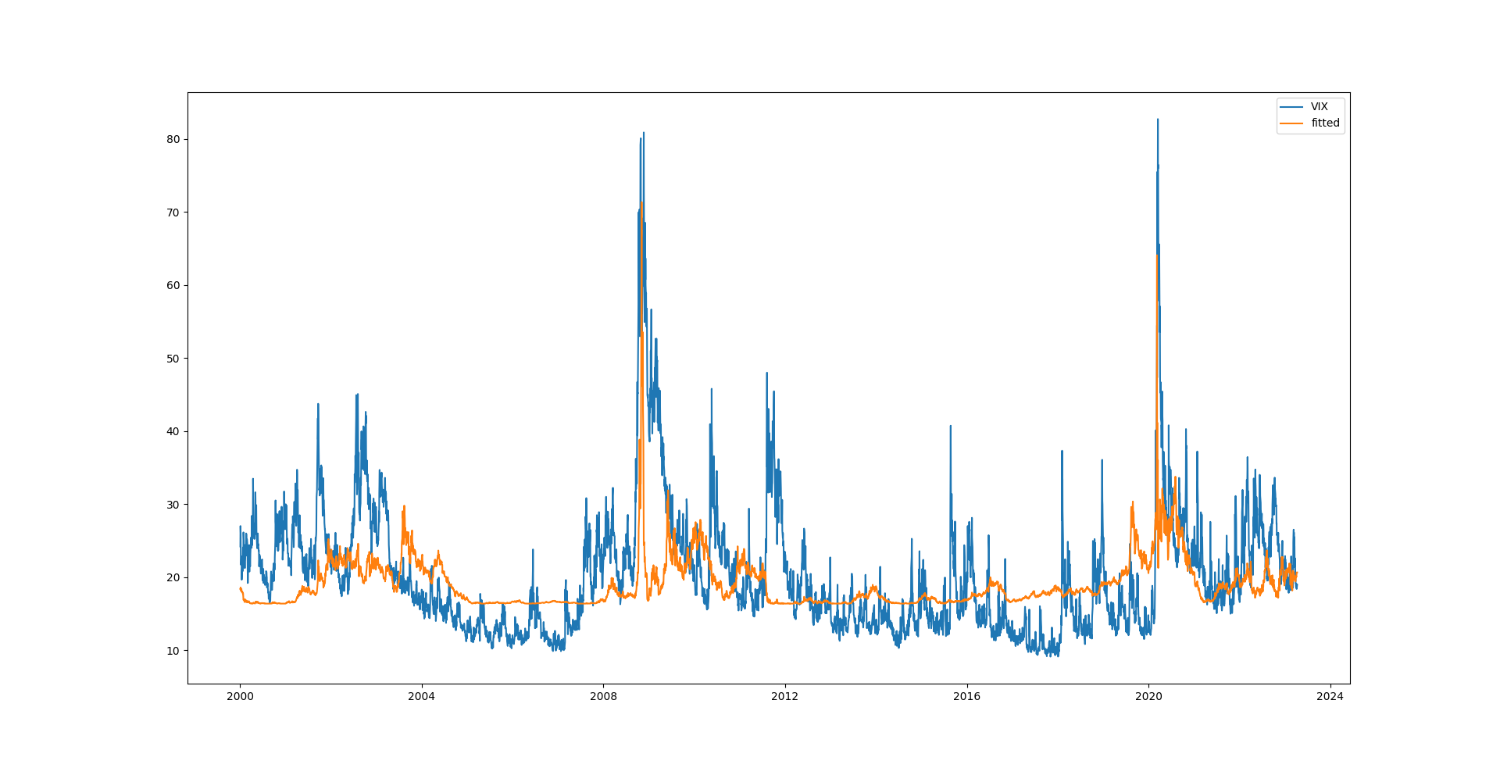

Slide 14
Possible Extensions
Could try to aggregate more features in the regression, e.g. curvature and temporal changes in term premia.
We have experimented with Term Premia surface input to a transformer encoder model, however did not observe improvements in accuracy.
The model complexity, small sample size, and noise in the data could cause this difficulting in fitting

Slide 15
Future Directions
The scatter plot inspire us to think the relation might not come from a simple regression, but instead a projection of manifold imbedded in higher dimension(e.g. Cylindrical surface in ℝ³).
With Atlas defined, we may model the comovement as some diffusion process on such manifold.
Or with the manifold specified, we could project the TP-VIX space into the third hidden axis, and research the characteristics of this new variable.

Slide 16
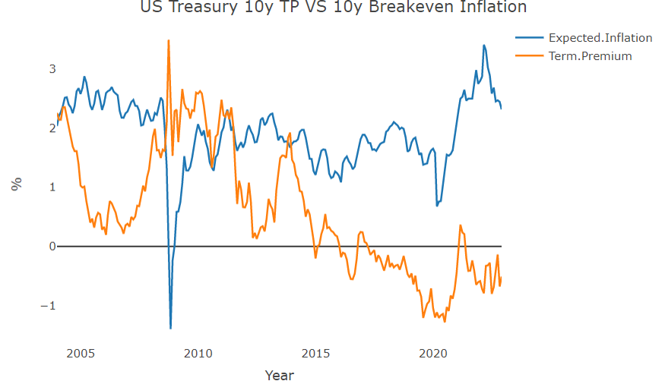
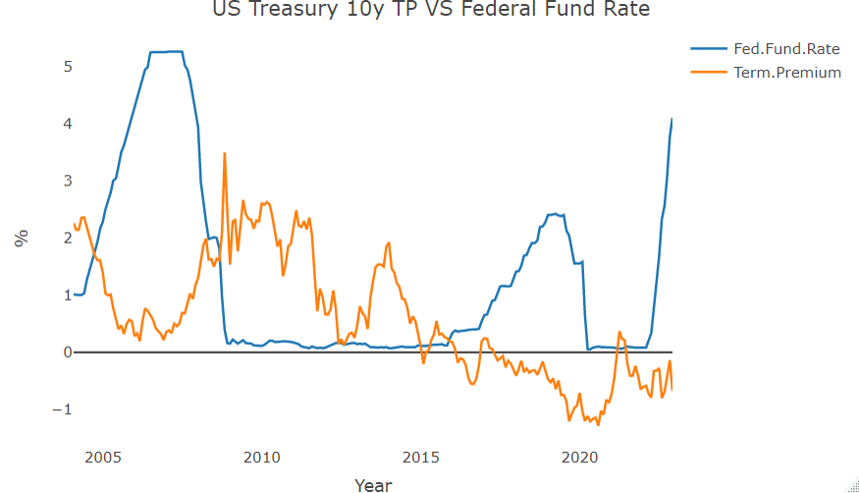
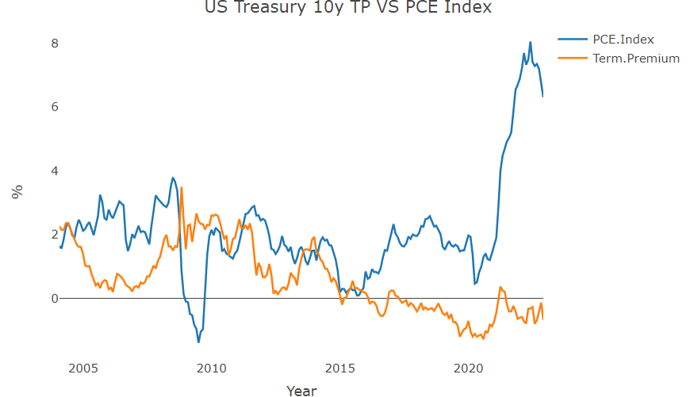
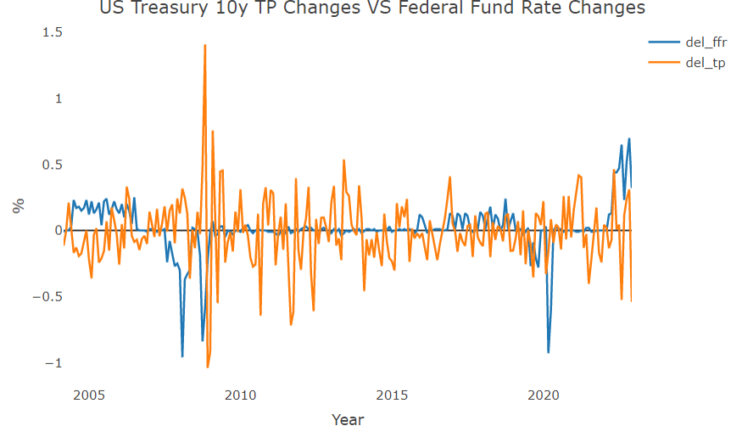
The relationship between Inflation and Term Premium

Slide 17
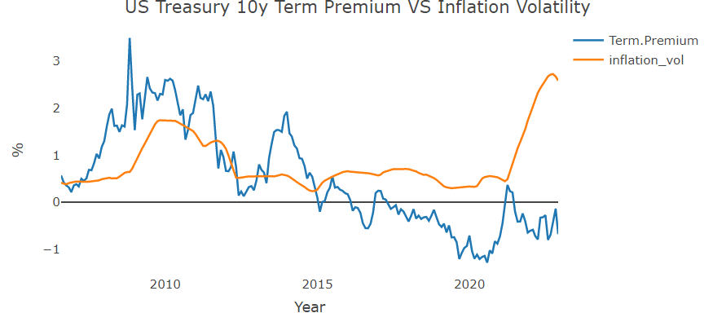
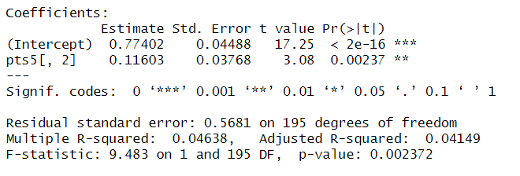
Empirical Finding A: Higher Inflation Volatility Corresponds to Higher Term Premium
2004 - 2022 data displays clear positive relationship between 10y term premium and volatility of inflation in the U.S.(gauged by the Fed’s Personal Consumption Expenditure Index).
This validates classic term premium theory which suggests that term premium comprise of 2 parts: the real term premium and the inflation premium. The inflation premium represents the compensation that investors demand for inflation risk.
When inflation volatility increases, investors require a higher term premium to compensate for the additional risks.This causes the 10-year term premium to rise.

Slide 18
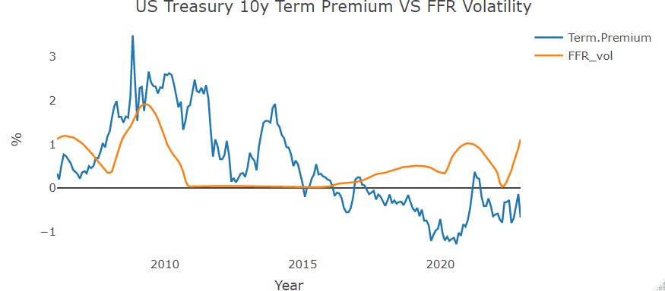
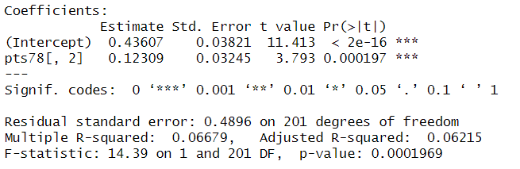
Empirical Finding B: Higher FFR Volatility Corresponds to Higher Term Premium
2004 - 2022 data also displays clear positive relationship between 10y term premium and volatility of Federal Fund Rate. This is because higher volatility in the federal funds rate can increase the uncertainty and risk associated with holding longer-term bonds.
When the federal funds rate is volatile, it can create uncertainty about the expected path of future short-term interest rates, which can in turn increase uncertainty about the future value of longer-term bonds. This uncertainty can lead investors to demand higher compensation for holding longer-term bonds, which can lead to an increase in term premia.

Slide 19
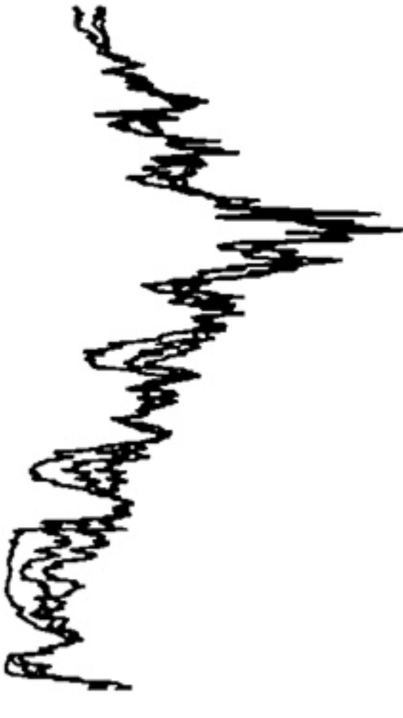
Forecasts based on different models for term premiums
The 10-year term premium is considered an important indicator of the fixed-income market because it reflects the market's expectations of future economic conditions and monetary policy. Analysts and economists pay attention to it because it is a reflection of the perceived risk of long-term investments and can influence investment decisions.

Slide 20
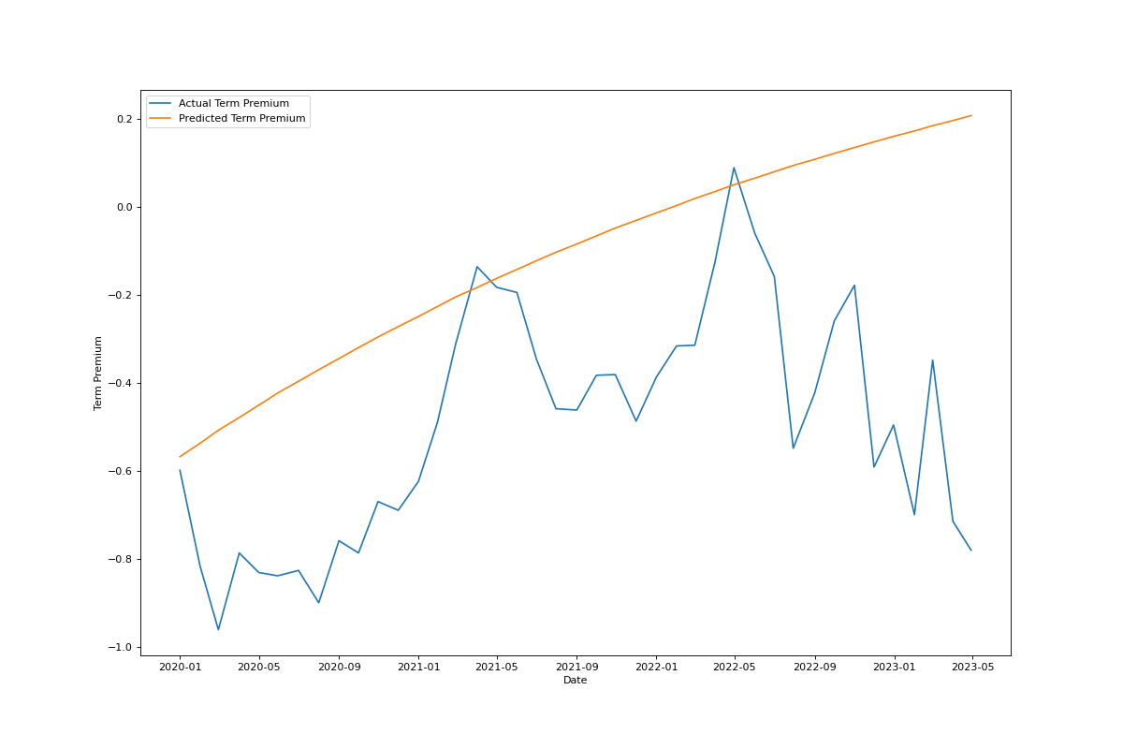
ARIMA Model
ARIMA is a commonly used time series forecasting method that models the dependence between consecutive observations in a series. It is suitable for modeling stationary time series, which are time series with constant statistical properties over time.
Term premium is a time series that measures the excess return on long-term government bonds relative to short-term government bonds, and is often assumed to be stationary. Therefore, ARIMA can be used to model and forecast term premium based on its historical behavior.

Slide 21
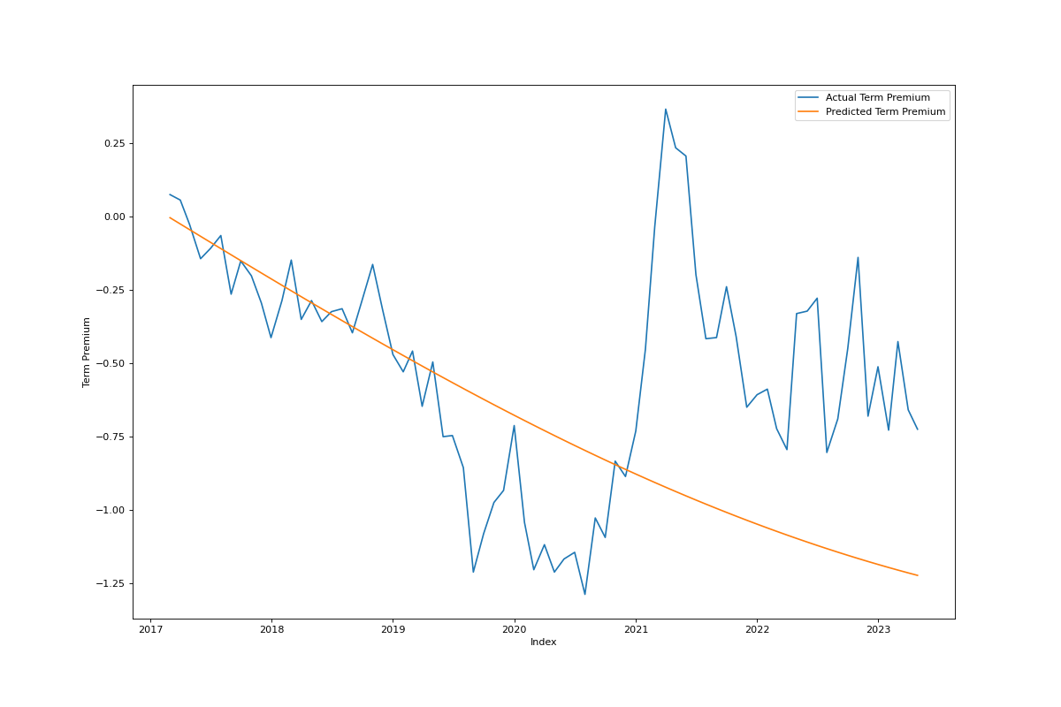
SVR Model
SVR (Support Vector Regression) is a powerful machine learning algorithm that can capture complex non-linear relationships between the input variables (independent variables) and the output variable (dependent variable).
In the context of predicting term premium, SVR can take into account various factors that affect the term premium, such as the prevailing economic conditions, inflation, interest rates, and so on. By training the SVR model on historical term premium data, it can learn to predict future term premium values based on the patterns and trends observed in the data.

Slide 22
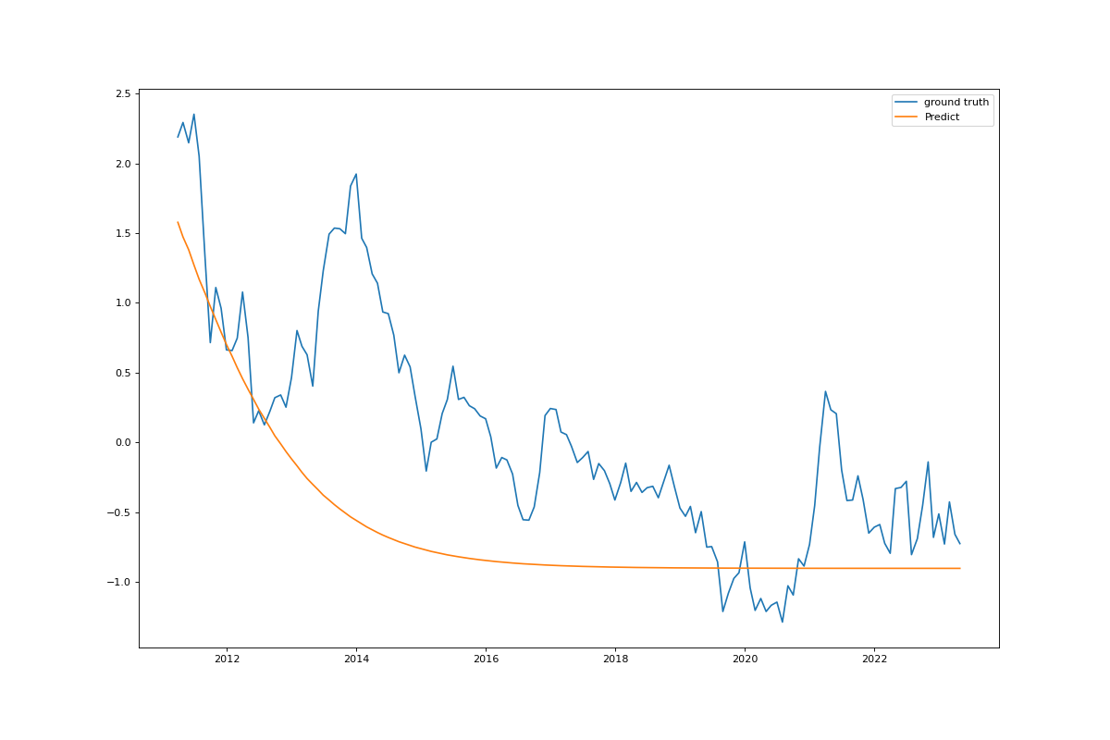
LSTM Model
LSTM is capable of capturing the long-term dependencies in time series data, which is a characteristic feature of term premium. As term premium is influenced by a variety of economic factors, such as inflation, economic growth, and monetary policy, LSTM's ability to capture these complex relationships makes it a suitable model for predicting term premium.
Additionally, LSTM can effectively handle nonlinear relationships and can handle missing data and variable length sequences, which makes it a flexible model for time series forecasting.

Slide 23
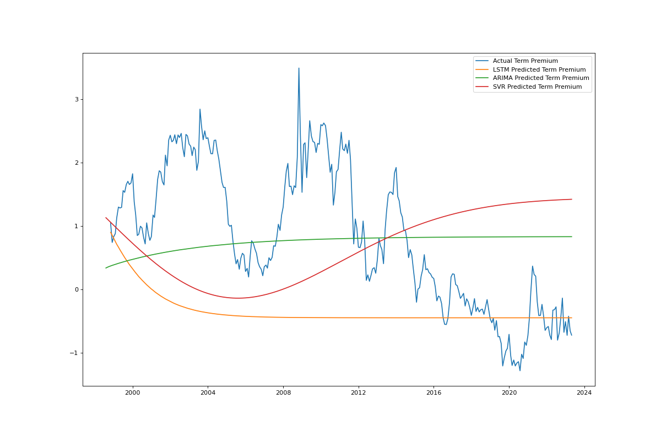
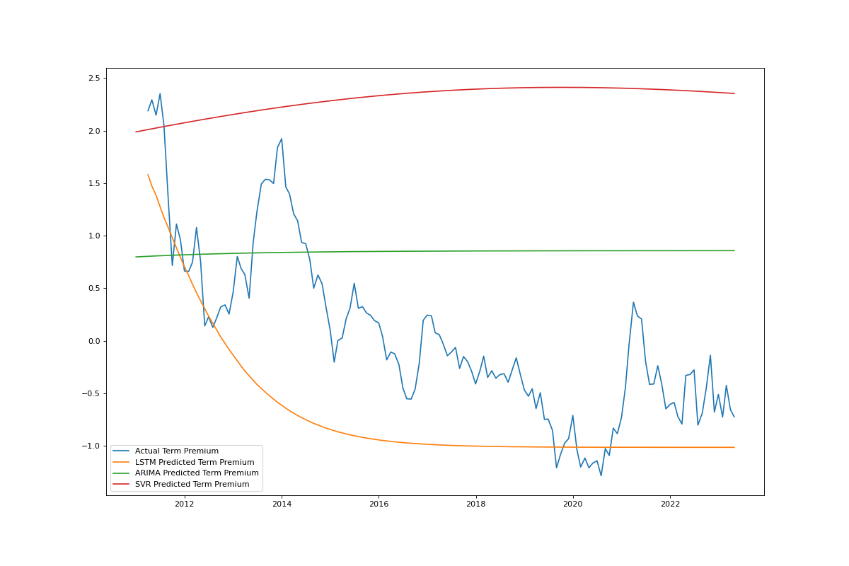
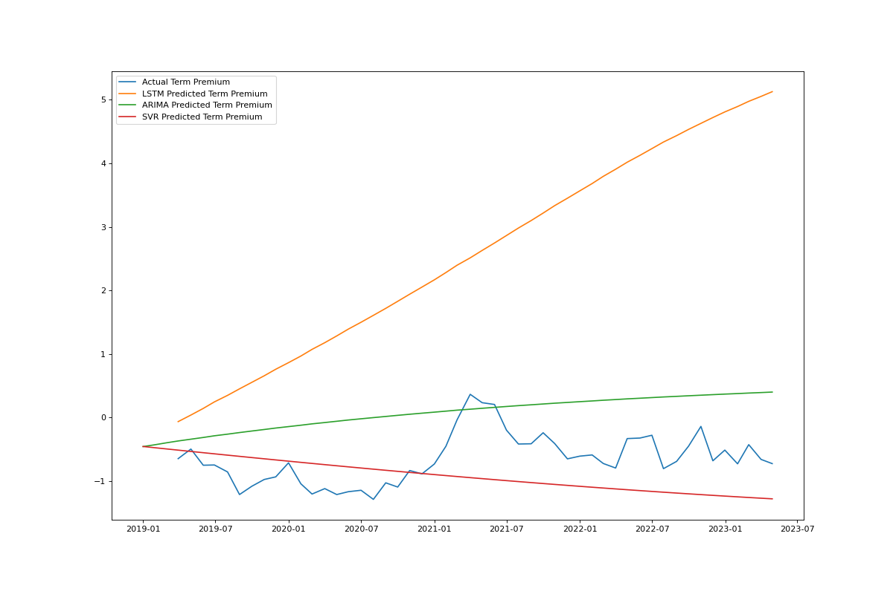
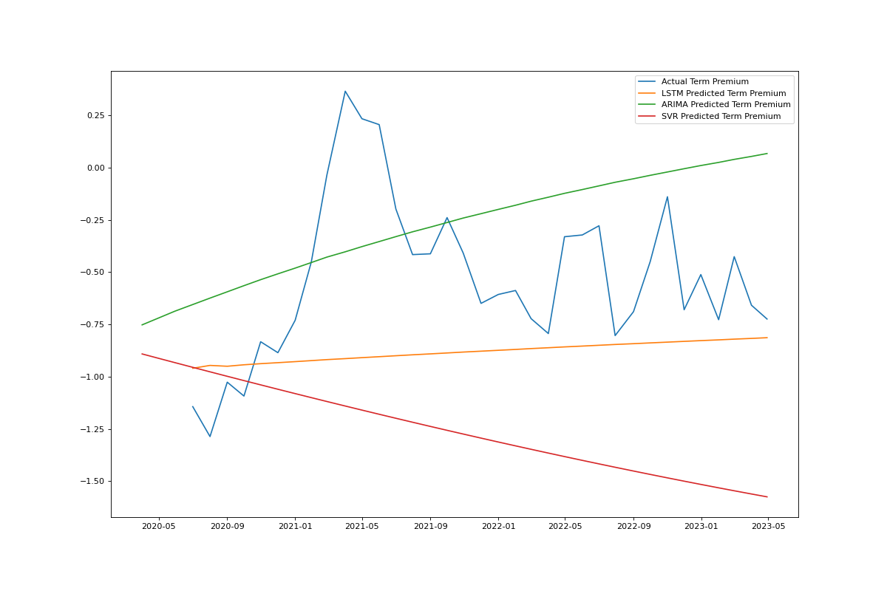
Comparison of the effect of the model in different time periods

